Slide 1

Introduction To Git

Slide 2
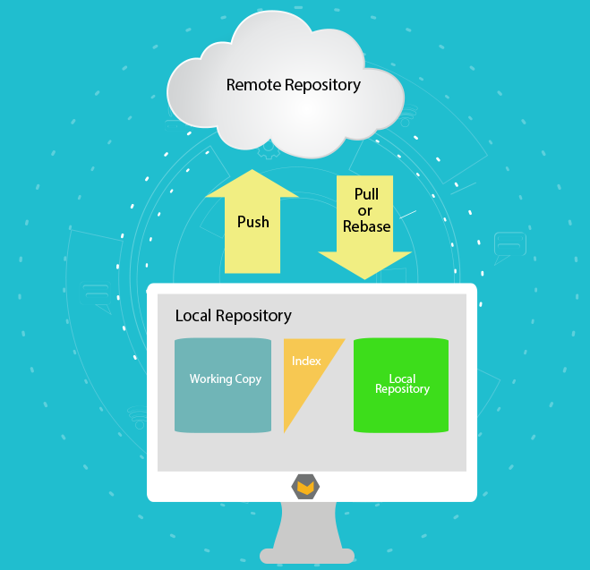
Terms Used in Git
A Git repository with the given files and directories, you can record their change history and start tracking their status and versions.
The working tree or Working Copy consist of files that you are currently working on. Is any directory on your filesystem which has a repository associated with it.
the index is a staging area where new commits are prepared. It acts as the interface between a repository and a working tree.

Slide 3
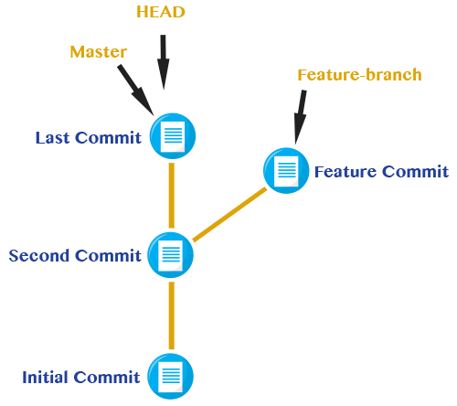
HEAD
is used by your repository to define what is currently checked out:
If you checkout a branch, HEAD symbolically refers to that branch, indicating that the branch name should be updated after the next commit operation.
If you checkout a specific commit, HEAD refers to that commit only. This is referred to as a detached HEAD, and occurs, for example, if you check out a tag name.

Slide 4
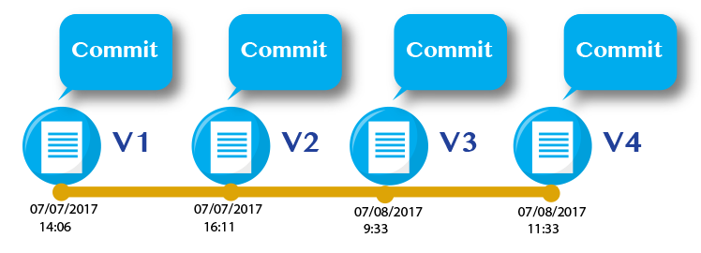
Commit

Slide 5

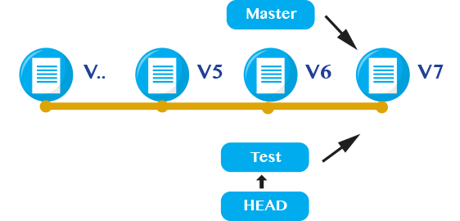
Branch o Ramas
master — The mainline of development in most repositories is done on a branch called master.
A branch is just a name for a commit (and much more will be said about commits in a moment), also called a reference. It’s the parentage of a commit which defines its history, and thus the typical notion of a “branch of development”.

